Slide 1
First Look at Fabric
From a User Perspective

Slide 2
Mimoune Djouallah (mim)
PowerBI developer. ( Ex Construction Planner)
https://datamonkeysite.com/ (blogs about PowerBI, BigQuery, Oracle Primavera and a bit of Data Studio & Construction)
nemtracker.github.io : Dashboard to Track Australia Electricity Market
Twitter @mim_djo
Linkedin : https://www.linkedin.com/in/mimounedjouallah/

Slide 3
Disclosure: a lot of fine print details are not known at this stage
It is just some personal observations not Facts
It is still in Preview
Don’t take any critics as a dismissal, this is the next big thing for Data and has already a vibe of PowerBI in 2016
Make your Feedback clear
Fabric Product Team do listen, specially now ☺

Slide 4
Nothing changed for PowerBI
If you have small data that don’t refresh frequently, Import Mode is perfect

Slide 5
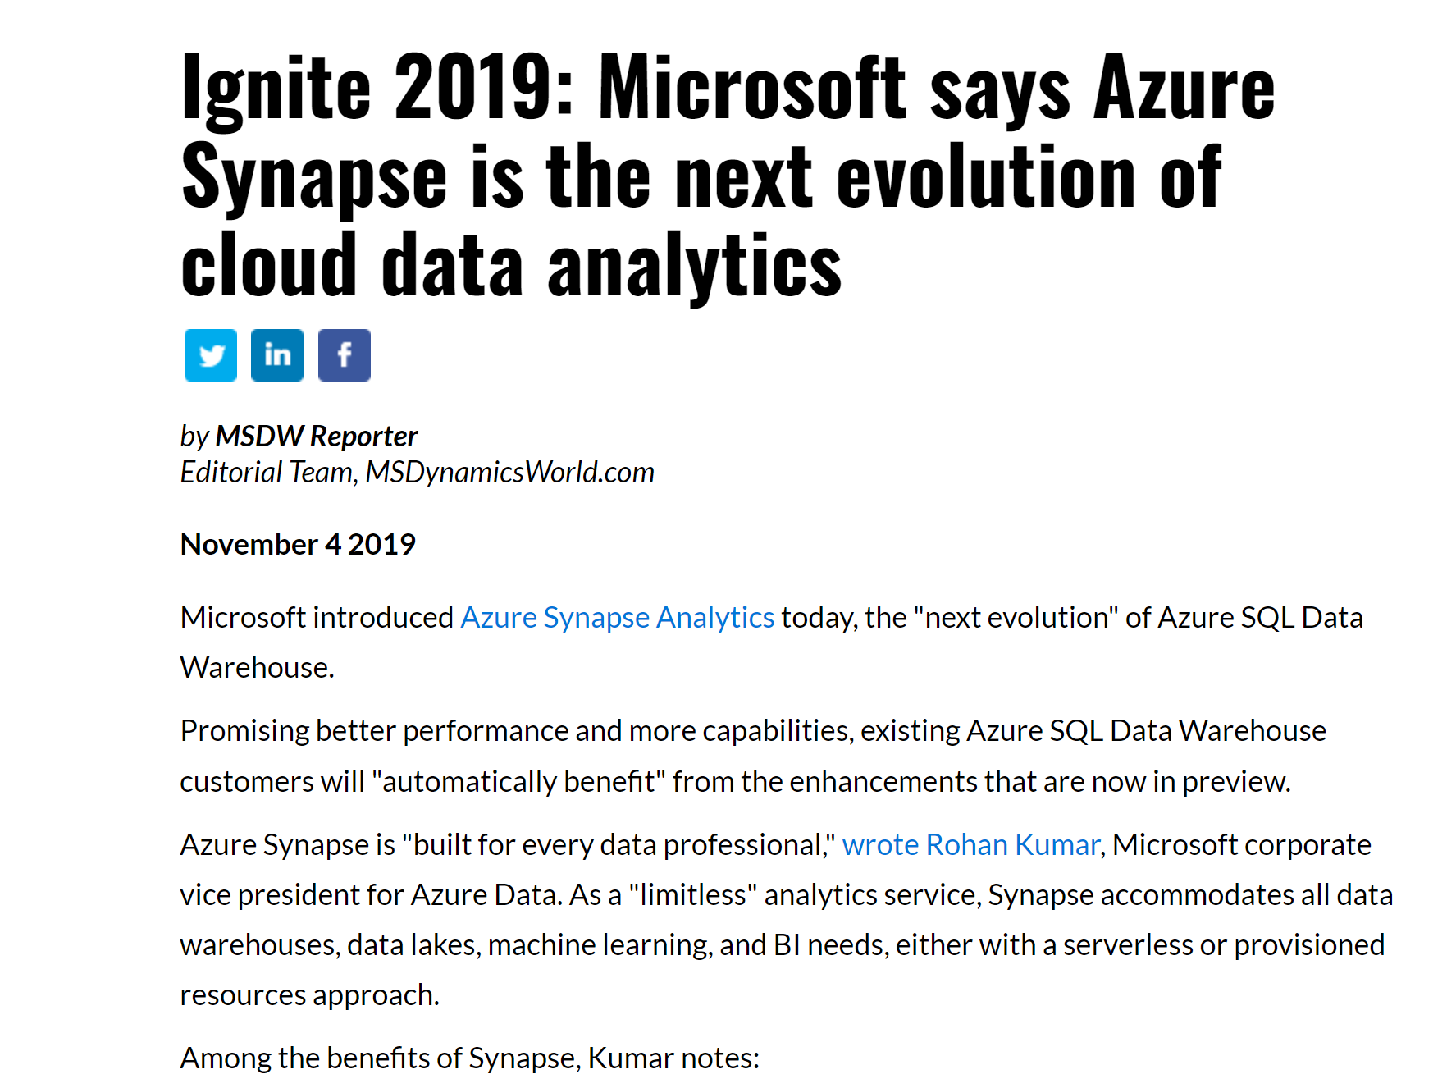
Historical Context

Slide 6
What was announced was never delivered Synapse Gen3 was not good enough

Slide 7
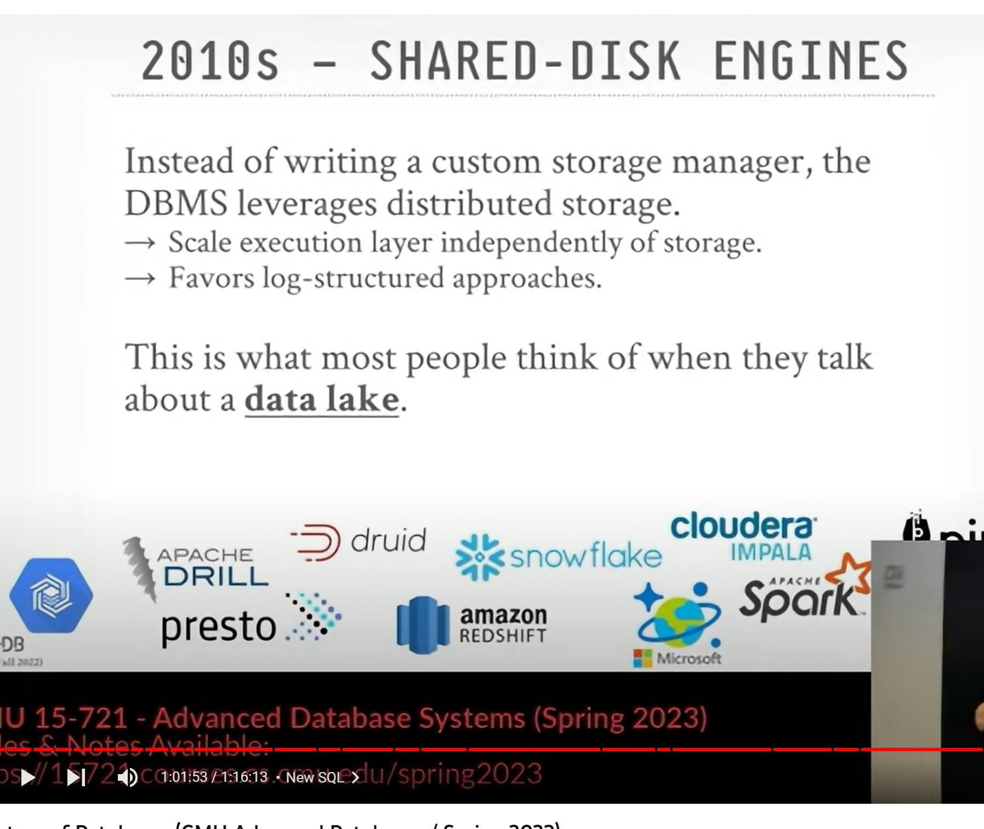
Separation of Storage and Compute

Slide 8

PowerBI Everywhere
- One of the Best Software invented beside Excel

Slide 9
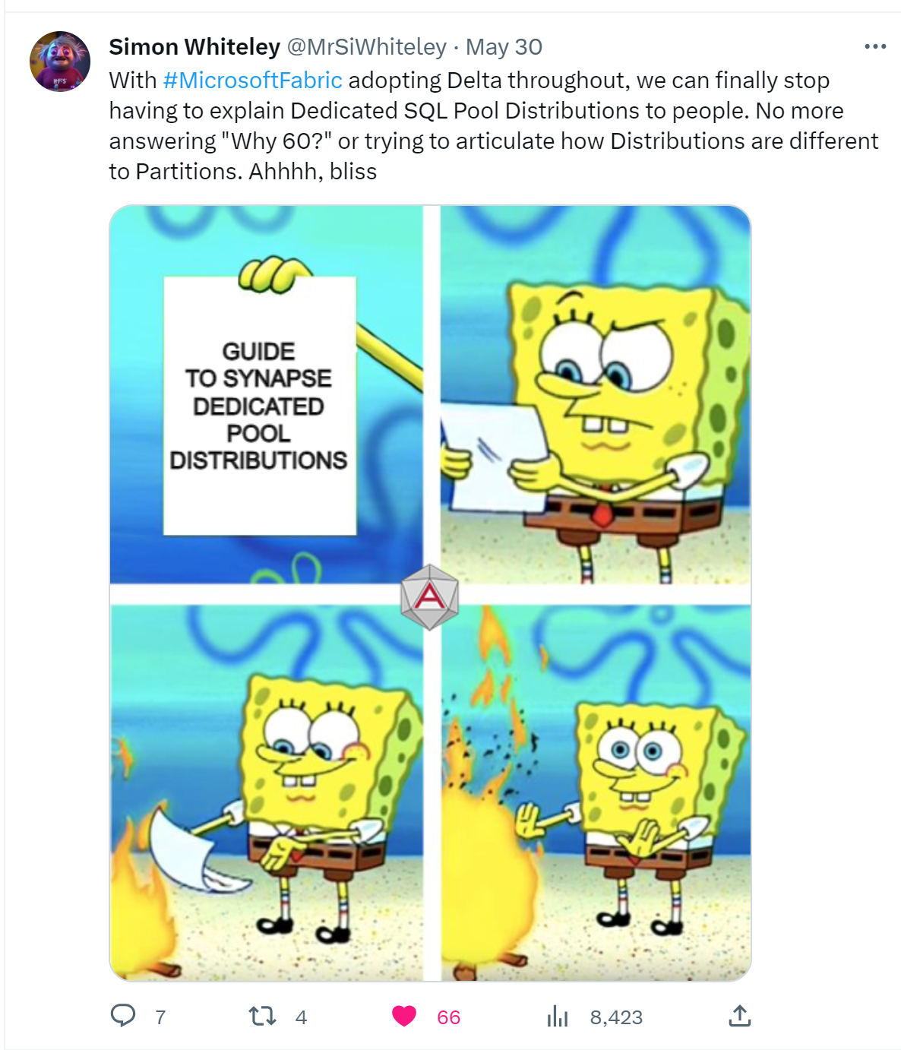
PowerBI Team took Over Synapse
Synapse Engines don’t talk to each Other
Synapse serverless don’t write Data
Dedicated Pool has the weird concept of Distribution, and is Basically a shared nothing architecture, Storage is basically coupled with Compute

Slide 10
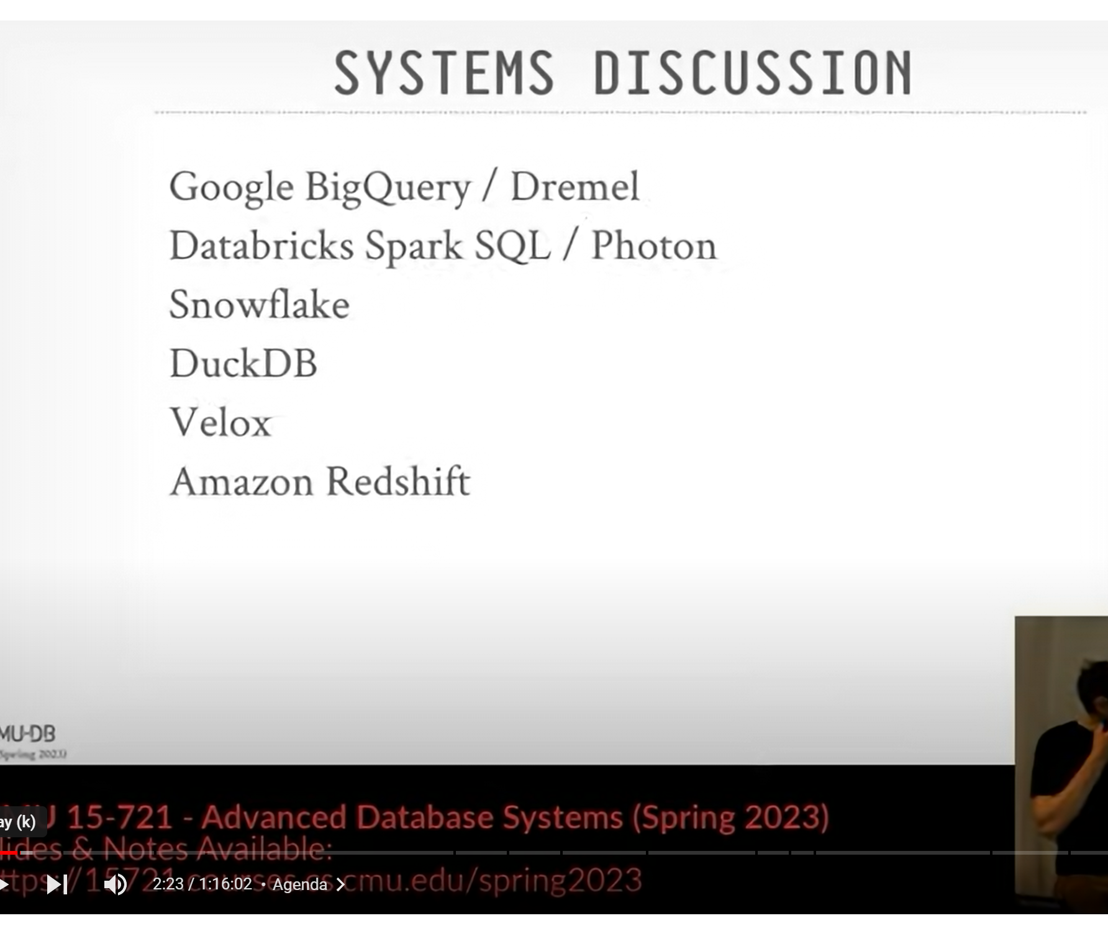
Whatever you think : Microsoft is not driving innovation in the Data Cloud space

Slide 11
There is Obviously a Problem

Slide 12

Fabric Core design decisions
- Merge Synapse and PowerBI Team Under the same Organization
Use Parquet as a File Format for Fabric DWH, That’s a very Bold Risky technical decision
Fabric Bursting

Slide 13
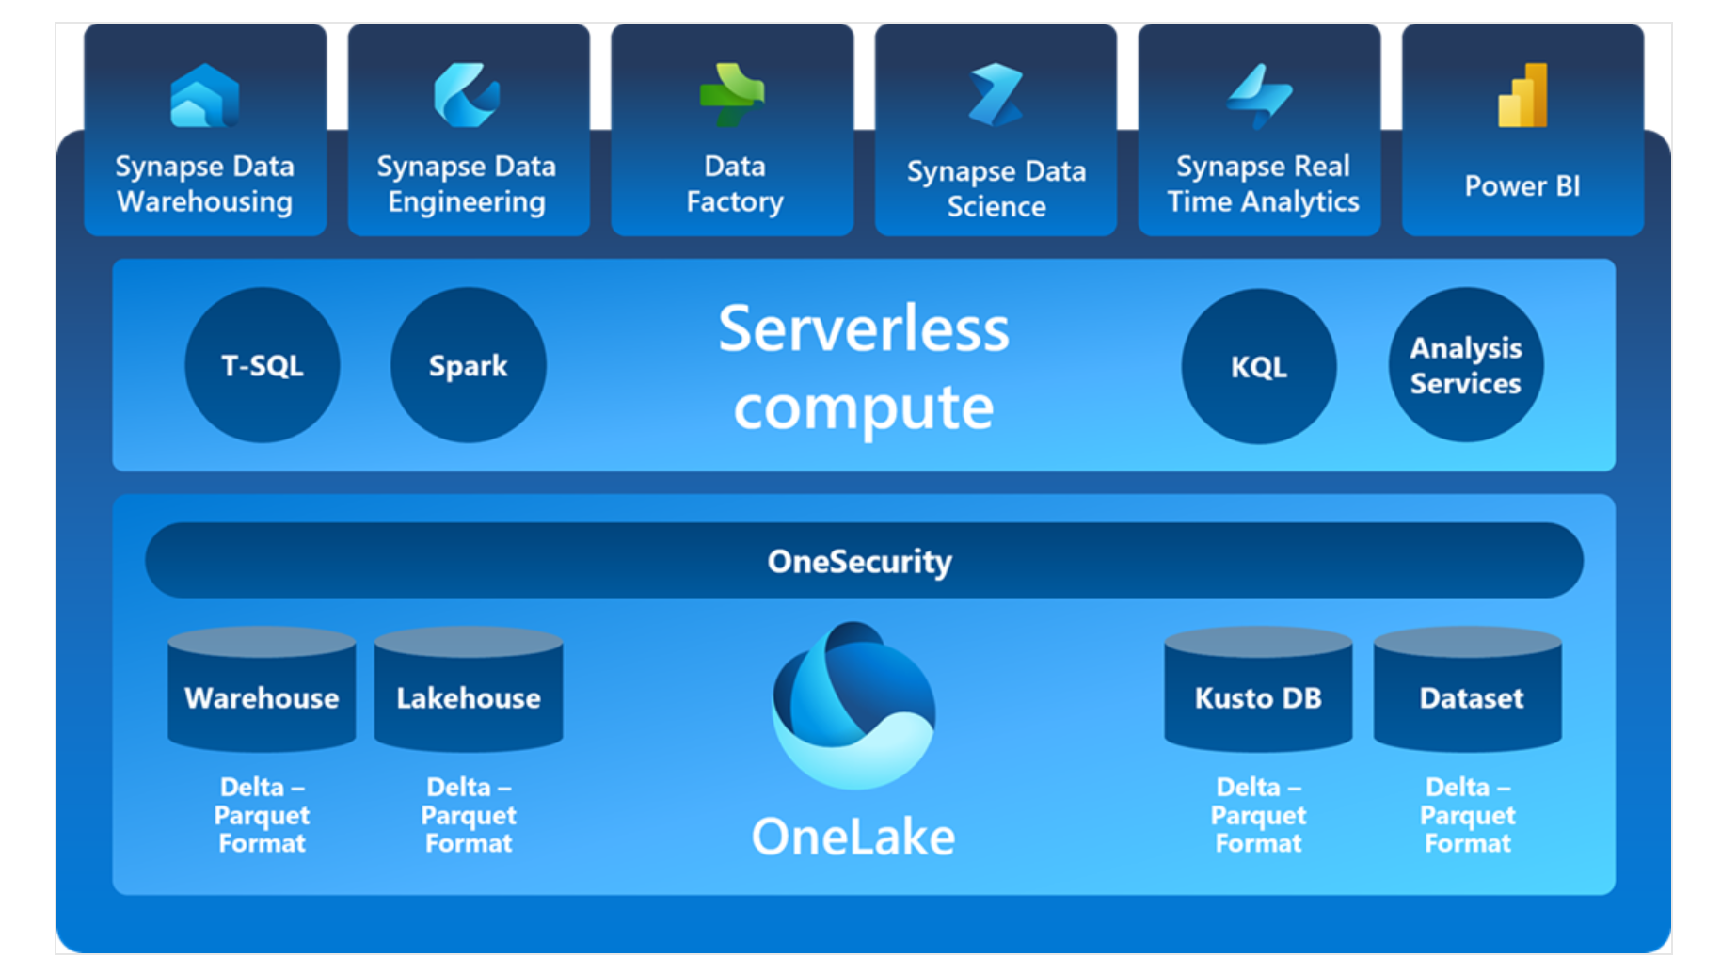
Fabric Architecture
Standard Storage Layer
Multiple Engines
OneSecurity not available yet
PowerBI Directlake
Two Writing Path
SQL for managed Table
Any tool can write to the LH

Slide 14
License
Capacity Only, no luck for PRO and PPU
P SKU : The best option, 1 Bill Guaranty
F SKU pay as you go : you can suspend and resume but …
No Real Automation ( not obvious how to capture PBI Workload)
You may pay for Bursting if you try to be very clever about it
F SKU Reserve Instance: This is what Microsoft want to you to buy
- Bill for Storage
- Bill for Egress fess
- Bill for storage transactions
- Bill for any extra service that they may want to release, they have your Credit card ☺

Slide 15
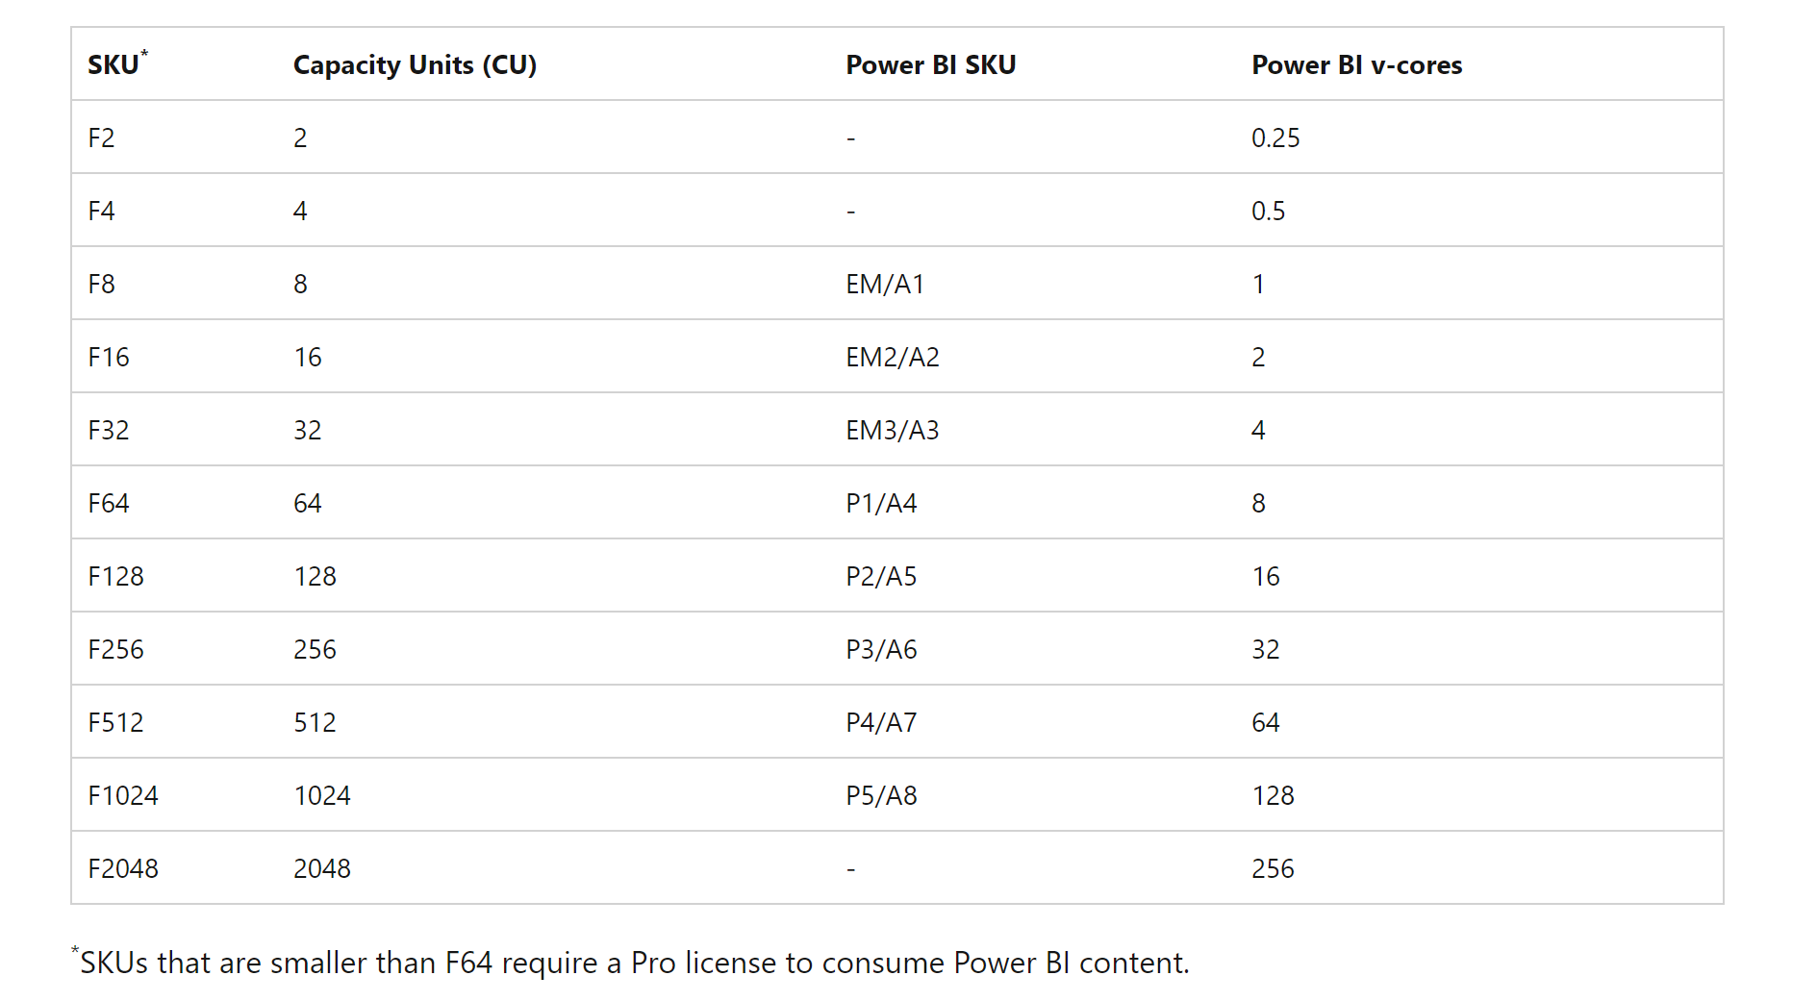
64 is the magic number
F64 IMHO is a different product category, and it is pretty much unique in the industry
Wishful Thinking, Microsoft can lower the bar anytime, maybe in a couple of years Free PowerBI reader will start with F32 ☺☺☺

Slide 16
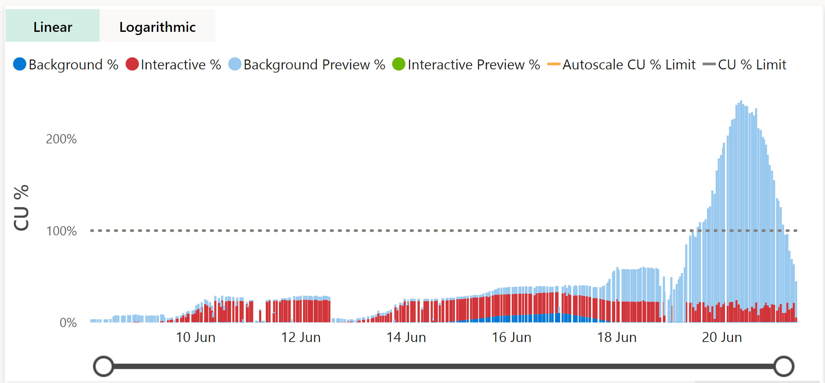
Fabric Bursting
Use Now Pay later
Use more resources to get the Task done then smooth it on a time period
Not sure how this Model will work for pay as you go model, do you get charged more if you suspend your capacity before paying back your extra charge

Slide 17
Lakehouse vs Datawarehouse
Fabric has two types of Engine
Engine that reads the Data, PowerBI don’t care if the data was written using the DWH or Spark, or any tool for that matter ( although it works better with V-Order)
Engine that Write the Data, Spark (or others) or DWH SQL Engine

Slide 18
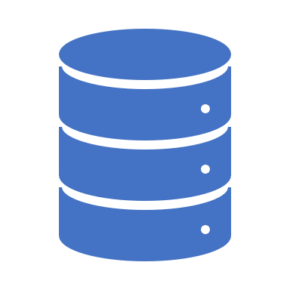
Managed vs Unmanaged Table
Both are Delta Table
DWH Table are written exclusively by the SQL Engine and are read Only outside of SQL Engine, vacuum, compaction etc is managed by the system
Lakehouse Table are read and write by anyone who has access to the Folder, concurrent write are guaranty only if you use Spark , Table maintenance is your problem
What to use ? That depends on your specific use case, pricing will be a big factor, but I suspect maybe both are useful
Whatever you choose, I think keeping raw data in a landing folder is a very good idea, after that, whatever make sense to you

Slide 19
Files in an Object Storage are immutable
Delete
Delete will Add files
Update
Update will add files
Append
Append will add files

Slide 20
Demo Delta Table Basic

Slide 21
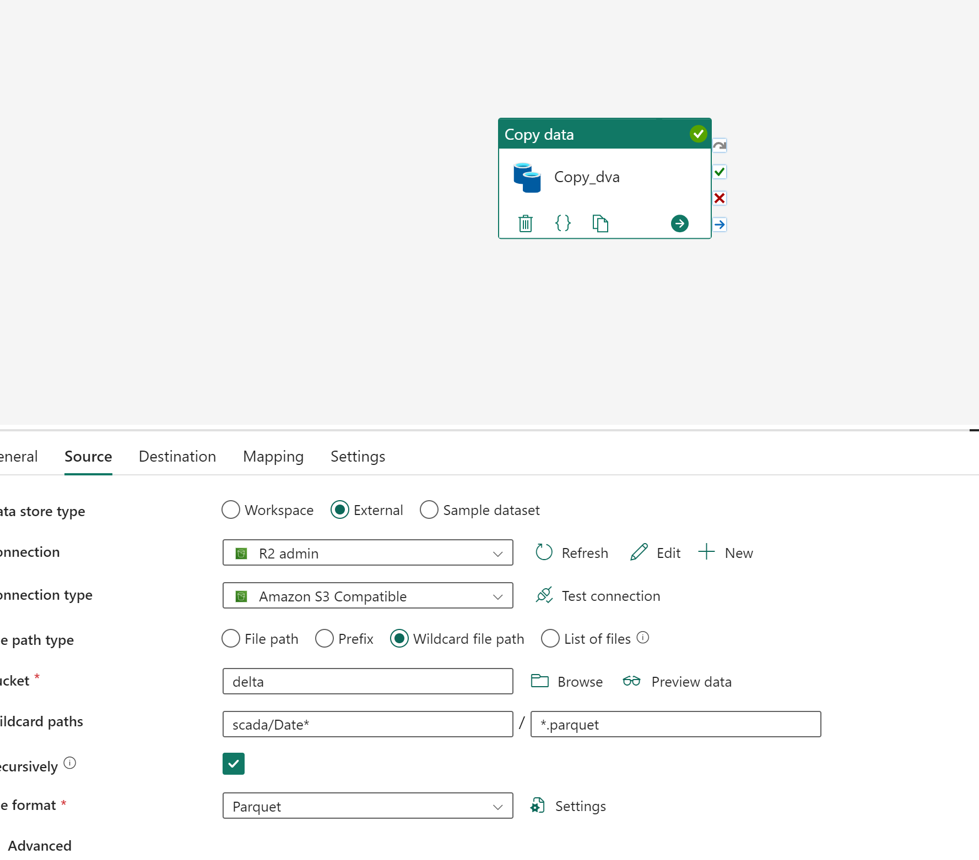
Demo Importing data to Fabric DWH

Slide 22
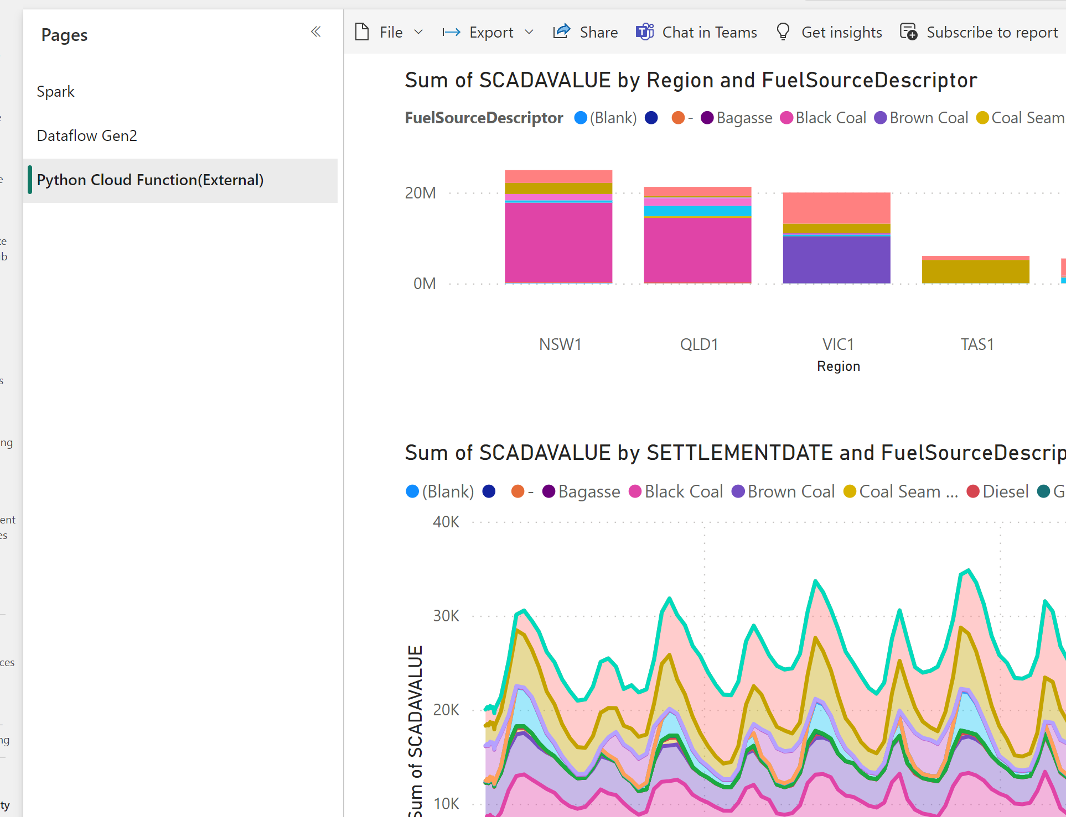
Show Demo Australian Electricity Price

Slide 23
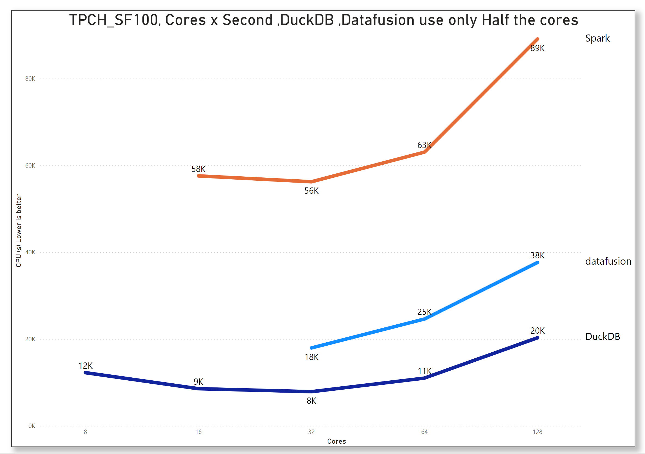
Demo Spark performance for Small Data

Slide 24
Final Thoughts
Don’t mess with The P SKU
The LH vs DWH is just a distraction, just merge the two and call it native table vs external table
Reduce Spark footprint in Fabric , Like in the LH UI
More investment in https://delta-io.github.io/delta-rs/python/
Hide the files inside the Delta table by default, it doesn’t feel right
Single node Python experience.

